Slide 1




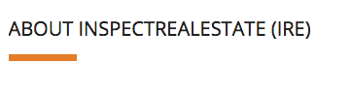

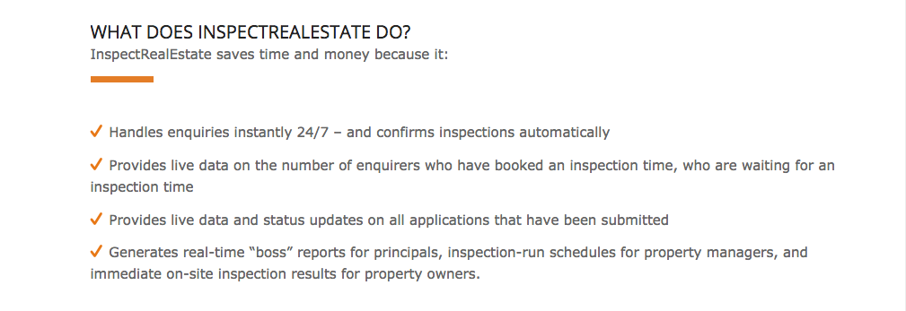

Keys gone missing?
Replace your manual key book in your reception with KeyTracker
FEATURES
PRICING
SUPPORT
TESTIMONIALS
FAQ
FEATURES
EASY ORDERING
Creating a new order has never been easier from your own home
Have your package on the way in minutes
ON-TIME GUARANTEE
✔ Never worry about when your package is getting delivered

Slide 2



PACKAGE HANDLED WITH CARE
Always know that your package will be safe and secure in our hands
CUSTOMISE ORDERS
✔ Make your order your way
✔ Choose from a variety of handling methods and package sizing options
PRIORITY SHIPPING
In a rush? We can save the day with express handling
You can be confident that your order will be there just in time!

Slide 3
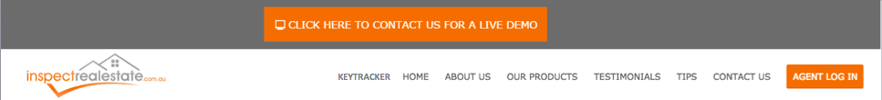
Keys gone missing?
Replace your manual key book in your reception with KeyTracker
FEATURES
PRICING
SUPPORT
TESTIMONIALS
FAQ
PRICING
Pricing
SMALL PACKAGES
$10-15*
MEDIUM PACKAGES
$20-35
LARGE PACKAGES
$40+

Slide 4



Packages under 5kgs
Perfect for small items like phones, watches and other personal items!
*Depends on location
SMALL PACKAGES
$10-15*
Packages larger than 15 kgs subject to custom pricing
MEDIUM PACKAGES
$20-35
LARGE PACKAGES
$40+
Packages from 5 - 15kgs
No matter how big your package, we have to delivery system for you

Slide 5

Keys gone missing?
Replace your manual key book in your reception with KeyTracker
FEATURES
PRICING
SUPPORT
TESTIMONIALS
FAQ
SUPPORT
Support
Our support team is ready to help and easy to reach via e-mail or by filling a quick fom on the support page!

Slide 6


Support
Our support team is ready to help and easy to reach via e-mail or by filling a quick form on the support page!
Web Support
E-mail Support

Slide 7

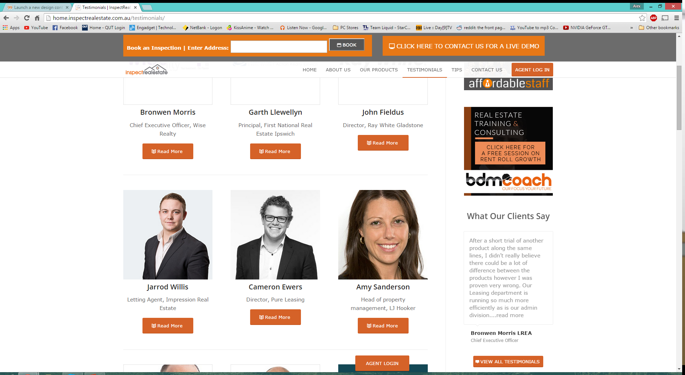
Keys gone missing?
Replace your manual key book in your reception with KeyTracker
FEATURES
PRICING
SUPPORT
TESTIMONIALS
FAQ
TESTIMONIALS
Testimonials
“The biggest technology-related improvement within the past 12 months in our office has very clearly stood out to be InspectRealEstate’s online booking system and its latest product key tracker.”

Slide 8
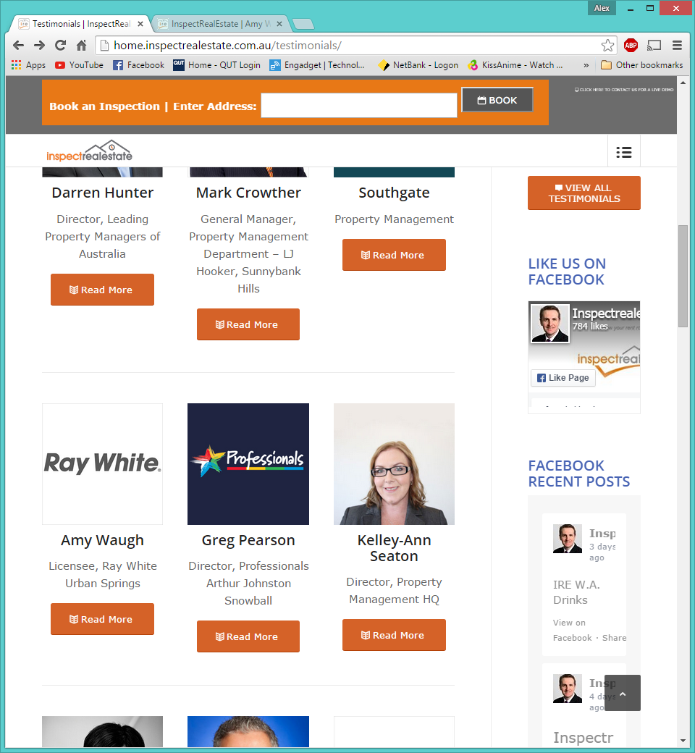
Testimonials
“The biggest technology-related improvement within the past 12 months in our office has very clearly stood out to be InspectRealEstate’s online booking system and its latest product key tracker.”
“KeyTracker is great. Our receptionist loves it and our tradespeople are really impressed with it too. They like the confirmation messages they receive when keys

Slide 9

and its latest product key tracker.”
“KeyTracker is great. Our receptionist loves it and our tradespeople are really impressed with it too. They like the confirmation messages they receive when keys are returned. It’s easy for us to track what keys are in and it saves time for everyone. We would recommend KeyTracker 100%.”

Slide 10

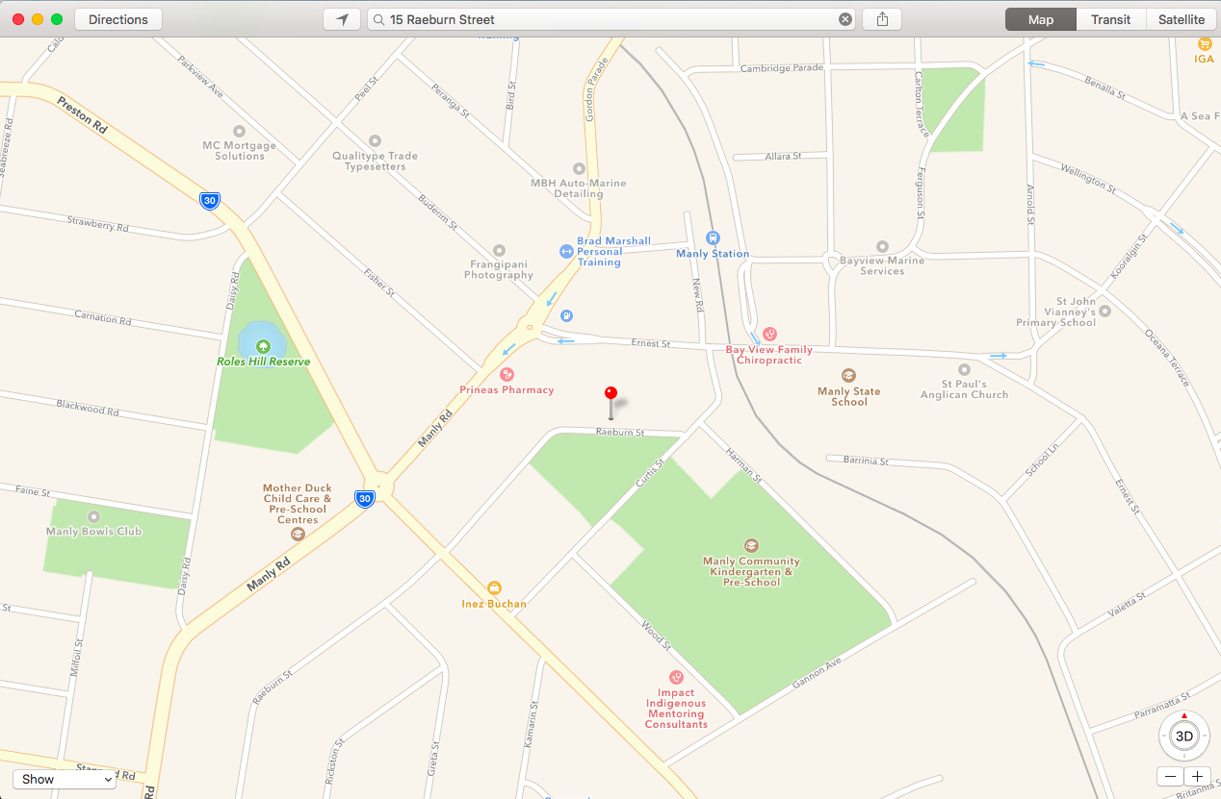
Delivery Schedule
:
Completed Orders
:
Order information
Customer information
Driver Hub
:
Roster Information
Work Email
Individual KPI Statistics
CONTINUE

